Slide 1
Data Management and Analysis with Python
Data collection through APIs and scraping

Slide 2
Trip
'Start Date'
'date_to_join'
'Start Terminal'
'End Date'
'End Station'
'End Terminal'
...
'Subscription Type'
'Start Station'
Weather
'Date'
'Max_Temperature_F'
'Mean_Temperature_F'
...
'date_to_join'
'landmark'
Landmark
'landmark'
'zip_code'
Station
'station_id'
'name'
...
'zip_code'

Slide 3
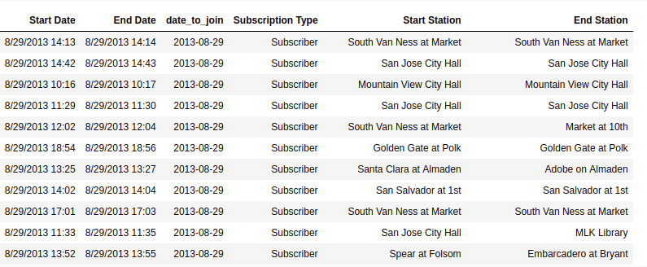
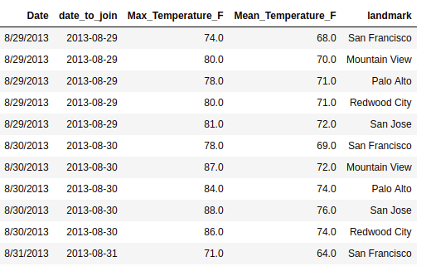
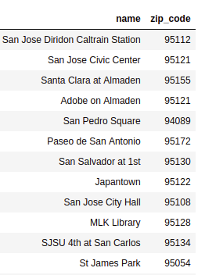
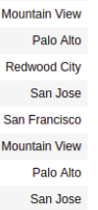
Creating dataframe for answering Q2

Slide 4
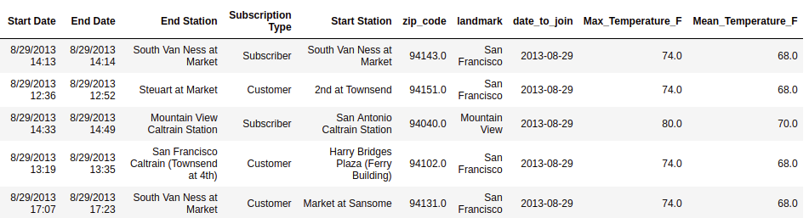

Slide 5
Web API
API stands for Application Programming Interface. In the context of the Web, this means that services provide programmable interfaces to other services or apps who want to build on top of their service.
Examples:
transportation systems provide APIs so that apps can make predictions about routes to take
Twitter, FB, and other online social networks allow to programmatically manage accounts and content, or download data via their API.
booking.com and other travel sites allow access to their data bases via APIs.

Slide 6


Communication with APIs
Request URL
Web Service
Client
API
Response JSON
Service using returned data

Slide 7
Request URL
https://api.instagram.com/v1/users/myUser/?access-token=ACCESS-TOKEN
https://www.google.com/maps/search/?api=1&query=CEU+campus
https://www.googleapis.com/books/v1/volumes?q=intitle:potter&maxResults=10

Slide 8
Response JSON
JSON is a data format used by any programming language. It is a way of encoding information as text. The structure is equivalent to the dictionary structure in Python which makes it easy to parse for us.
import json json.loads(json_object)

Slide 9
{
"id": "X999_Y999",
"from": {
"name": "Tom Brady", "id": "X12"
},
"message": "Looking forward to 2010!", "actions":
{
"name": "Comment",
"link": "http://www.facebook.com/X999/posts/Y999"
},
{
"name": "Like",
"link": "http://www.facebook.com/X999/posts/Y999"
}
"type": "status",
"created_time": "2010-08-02T21:27:44+0000", "updated_time": "2010-08-02T21:27:44+0000"
}

Slide 10
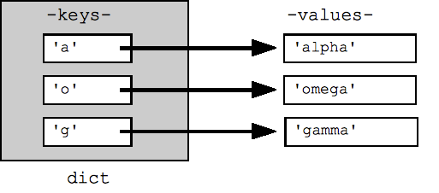
Dictionaries
Dictionaries are also an unordered set of elements, so called keys which are each associated with a value. So essentially dictionaries are a set of key-value pairs.
Values can be of any type, even more complex data structures such as a list or another dictionary.
You can think of keys as IDs or handles that let you access the associated information.

Slide 11
Dictionaries
You can use a dictionary when you have a set of unique keys that map to values, for example, usernames and associated features.
Keys of the dictionary are always unique.
Also, they are unordered, which means you might put in elements in one order but then get them back in a different order.

Slide 12
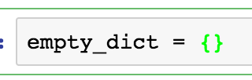

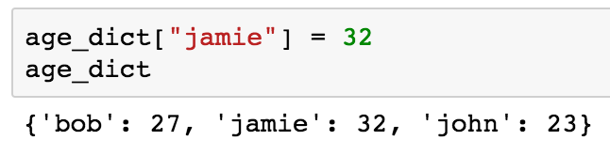
Dictionaries
Creating an empty dictionary
Creating a dictionary with elements:
Adding a key-value pair:

Slide 13
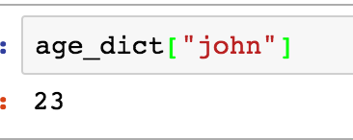
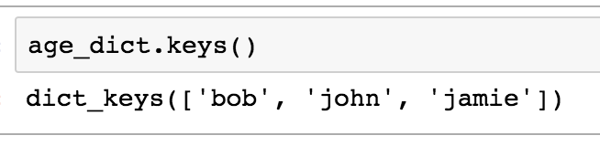
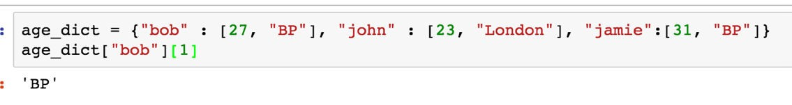
Dictionaries
Asking for the value of an element:
Listing all keys:
More complex values
See documentation: https://docs.python.org/2/tutorial/datastructures.html#dictionaries

Slide 14
Online data collection
Sometimes you have a question, but don’t have the data that could answer it. Collecting data from the internet is a powerful tool for these situations.
There are multiple ways to collect online data. Today we’ll learn about scraping HTML:
using algorithms to collect html codes from websites and parse them to get the information you need.
For example you can
Download tables of prices and products automatically from an online store or travel site
Download all images quickly from an album
Collect meta information about you and your friends on Facebook and draw a network of it

Slide 15
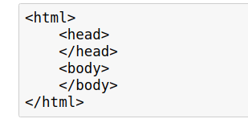
HTML
First, let's see what `html` is. HyperText Markup Language (HTML) is a language that web pages are created in. HTML isn't a programming language, like Python — instead, it's a markup language that tells a browser how to layout content. HTML allows you to do similar things to what you do in a word processor like Microsoft Word — make text bold, create paragraphs, and so on.
HTML consists of elements called tags. They work like brackets that nested into each other.
This code below results in an empty page if you compile it since nothing is in the body:

Slide 16
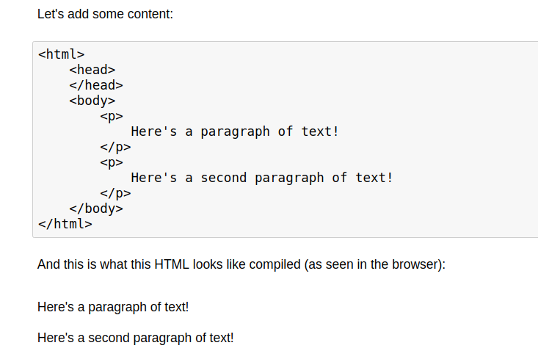

Slide 17
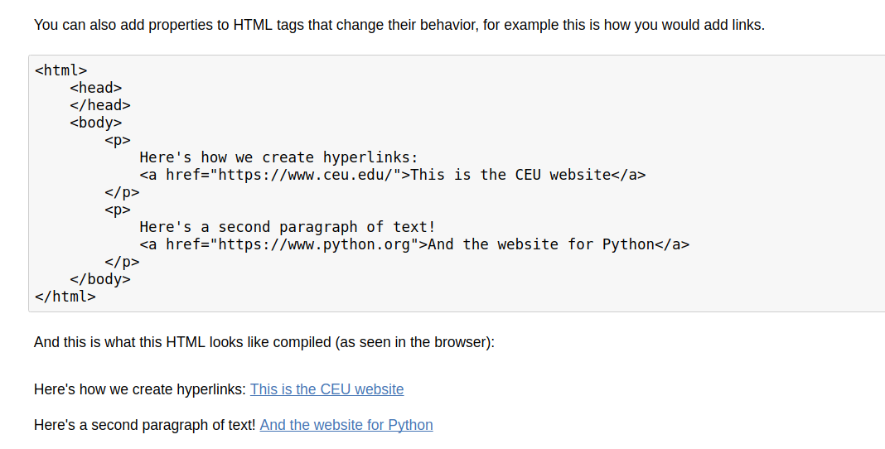
`a` and `p` are extremely common html tags. Here are a few others:
- div: indicates a division, or area of the page.
- b: bolds any text inside.
- i: italicizes any text inside.
- table: creates a table.
- form: creates an input form.
You can find a full list here: https://developer.mozilla.org/en-US/docs/Web/HTML/Element

Slide 18
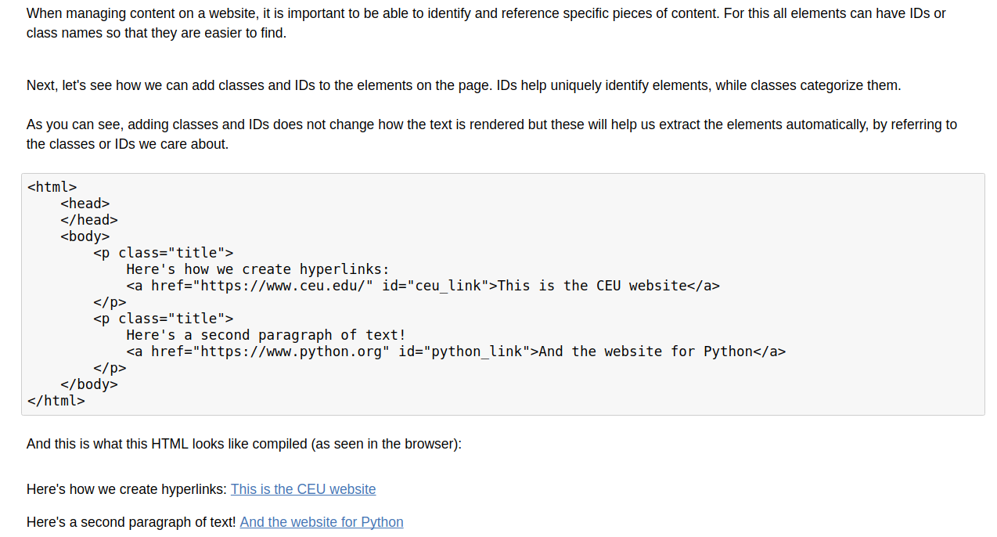

Slide 19
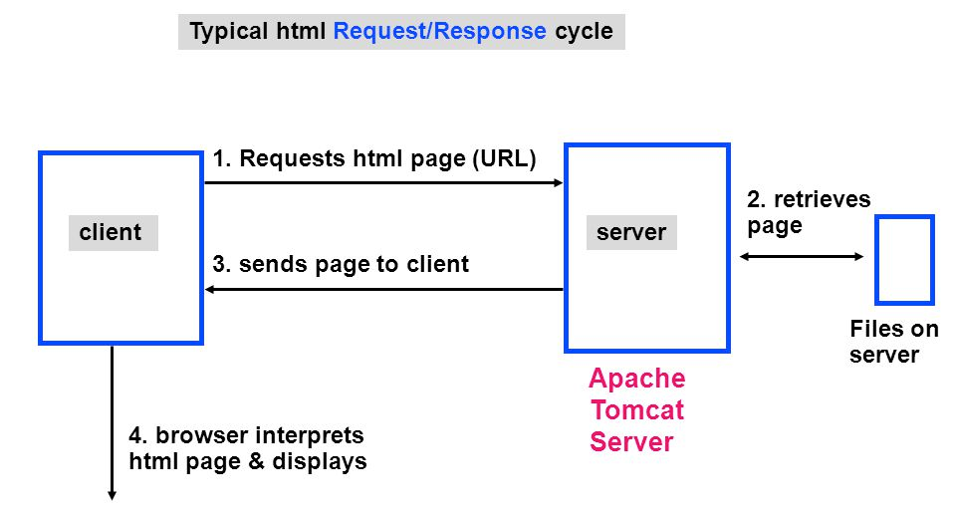
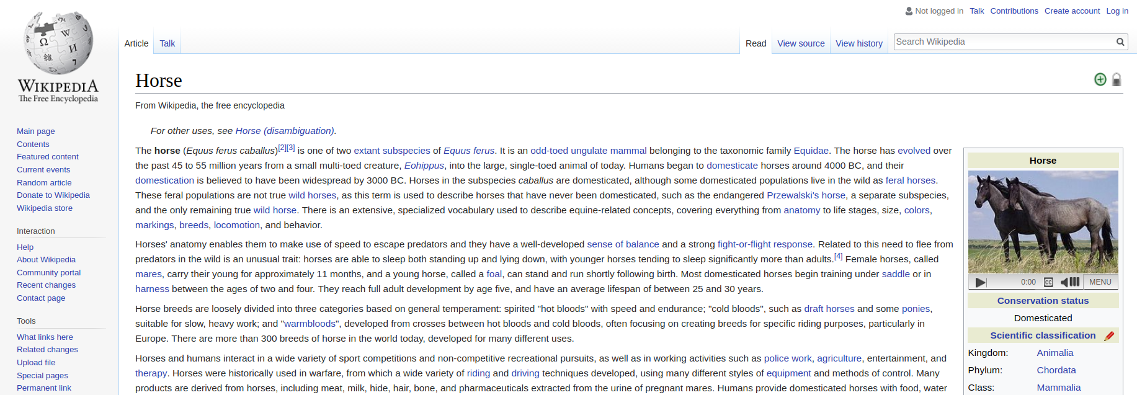
Communication with the server
When you type in a URL and hit enter, there is a request that being sent to the host of the webpage and it responds with loading the webpage.
https://en.wikipedia.org/wiki/Horse
Notes:
file is just a file on the server, you can write that. so let’s see what that looks like:
and then show the source code for the page.

Slide 20
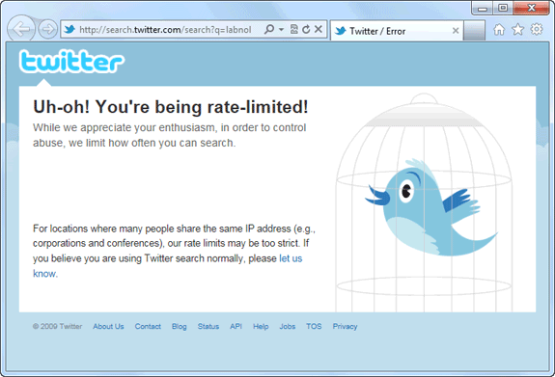
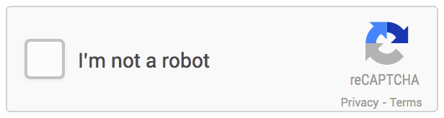
Limits
Rate limits
Legal issues
Grey area. Depends on Terms of Service, the purpose of scraping, data storage …
Inform yourself about these before you do a scraping project!
Web Servers often limit the number of requests they allow form the same IP address X request/day/auth
Notes:
big data base of these unique addresses somewhere on the web and you can reserve them.

Slide 21
Crawling/Scraping Web Pages
Crawling means that we download the content of web pages in an automated way. We can do this through Python using the “requests” library.
You can provide python the URL of the page and it will download the content. This means python handles communication with the server in the background.
Crawling is the first step into analyzing online data. The workflow usually consists of
crawling —> parsing out useful metadata —> analyzing data
Notes:
big data base of these unique addresses somewhere on the web and you can reserve them.

Slide 22
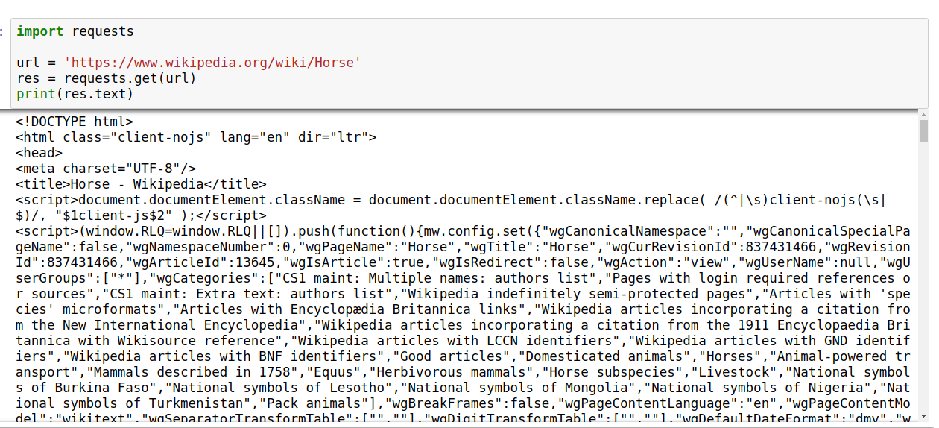

Slide 23
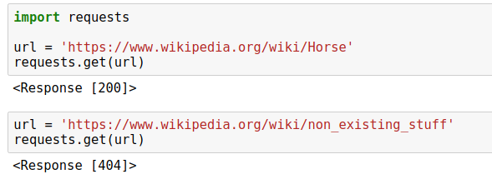
Response codes
The response code informs you if the request was successful or about the type of the error. See a list of the codes here:
http://www.restapitutorial.com/httpstatuscodes.html

Slide 24
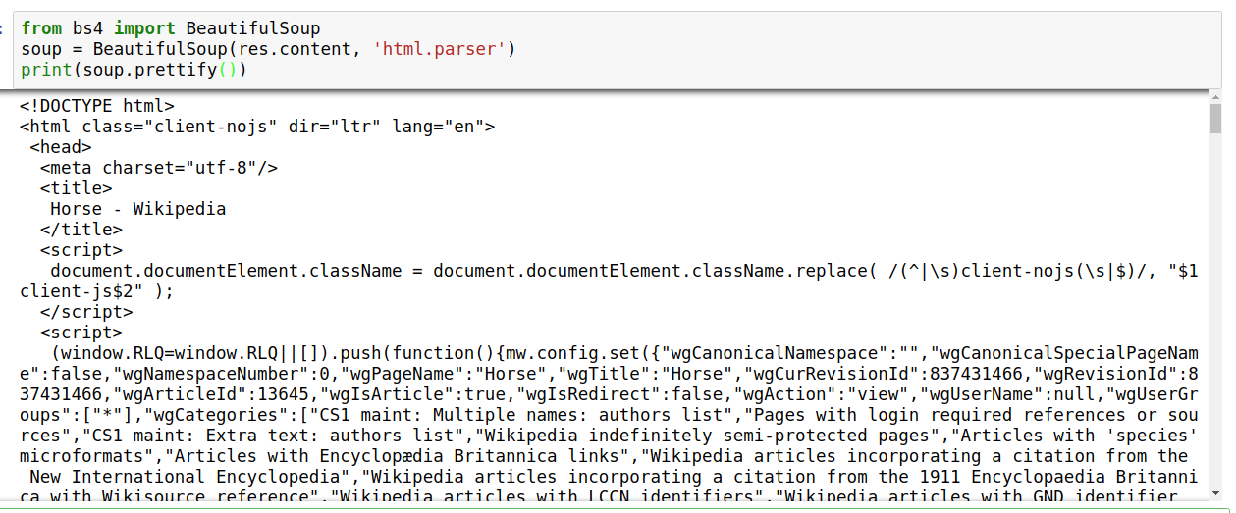
Make parsing easier: BeautifulSoup

Slide 25
Scraping HTML vs using an API
API is the ofﬁcial/legal way of collecting data in an automated manner
API returns a json object that is easy to parse
APIs often limit to the number of requests you can send and it is set quite low.
With APIs the service decides what information to share, what subset of the data to show you.
With HTMLs, you can scrape exactly what the user sees, not just what is deﬁned in the JSON provided by the API. For example ads, images, personalized content.

